Slide 1
MEMBRANE STRUCTURE & FUNCTION
Chapter 5

Slide 3
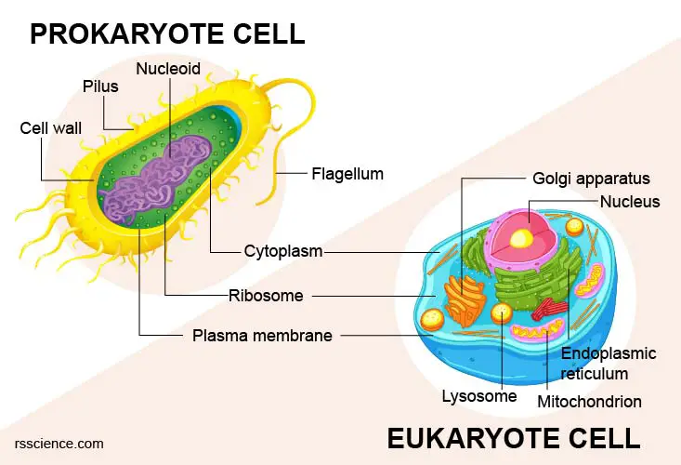
PLASMA MEMBRANE Review
All cells have plasma membrane made of proteins & lipids
Some cells also have outer cell wall (plants, fungi, bacteria)
Selectively permeable
Controls what enters & exits the cell
Site of many chemical reactions
Receptors provide information regarding environment

Slide 4
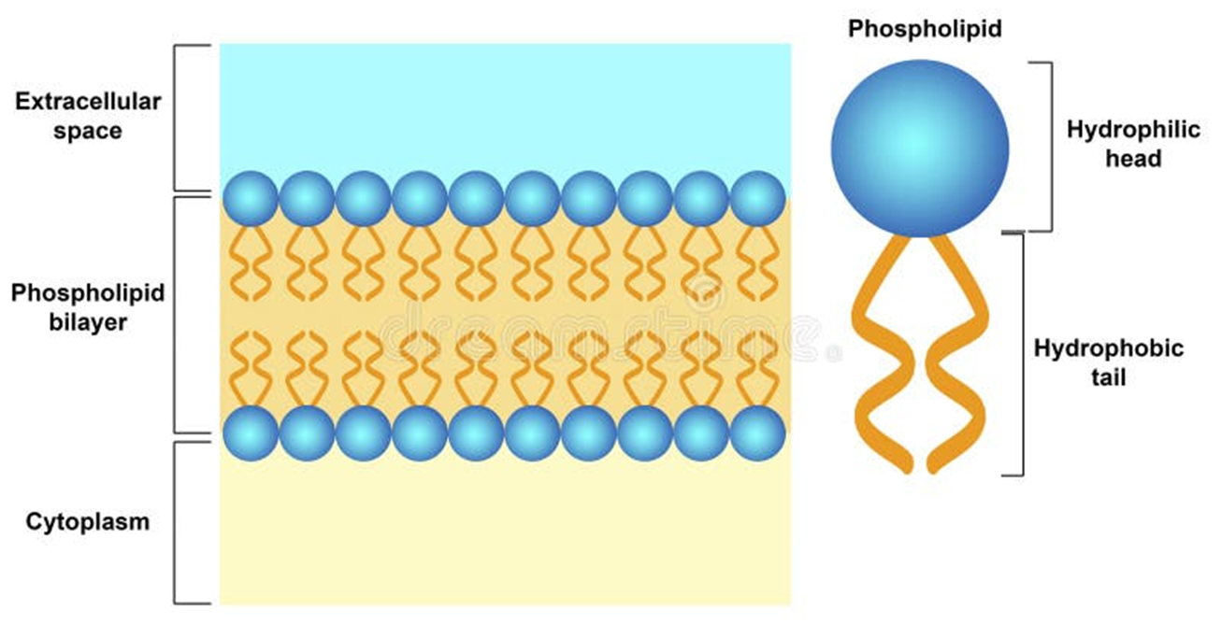
PHOSPHOLIPID BILAYER

Slide 5
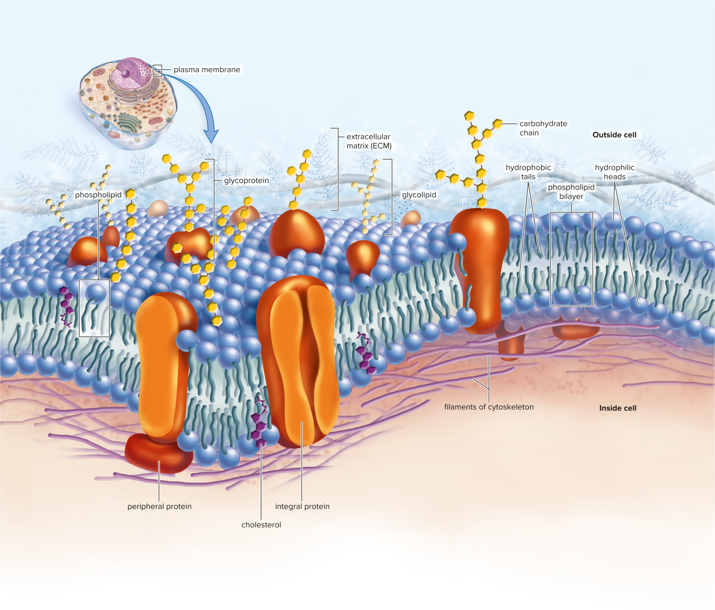
FLUID-MOSAIC MODEL
Model of plasma membrane based on changing location & pattern of proteins
“Mosaic”
Pattern or image formed by small pieces
Membrane is pattern of different types of molecules
“Fluid”
Ability to flow easily
Molecules in membrane constantly moving in both directions

Slide 6
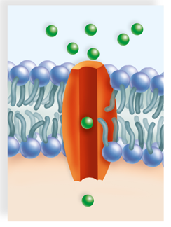
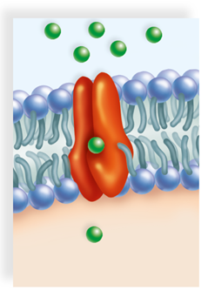
MEMBRANE PROTEINS
CHANNEL PROTEINS
Involved in passing small molecules or ions through membrane
Forms channel allowing molecules to move from one side to other
Ex: Cystic fibrosis – faulty channel
CARRIER PROTEINS
Involved in passing larger molecules through membrane
Change shape to move substance from one side to other
Ex: Na-K pump

Slide 7
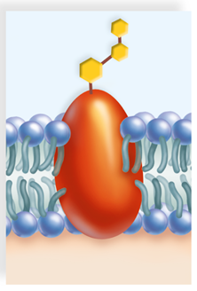
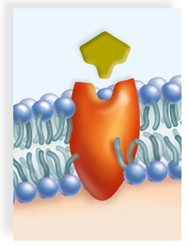
MEMBRANE PROTEINS
CELL RECOGNITION PROTEINS
Glycoproteins – have carbohydrate chain marker (unique to individual)
Recognize foreign cells by different marker – send signal for immune response
Ex: Blood type
RECEPTOR PROTEINS
Have shape allowing only a specific molecule to bind to it – “lock-and-key”
Binding causes protein to change shape which signals cell for response
Ex: Insulin receptor

Slide 8
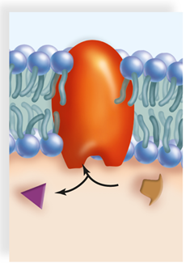
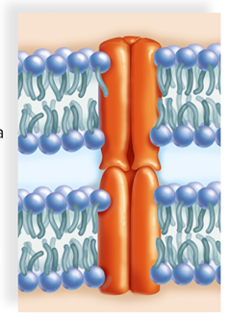
MEMBRANE PROTEINS
ENZYMATIC PROTEINS
Carry out specific chemical reactions
Required for cell metabolism
Ex: Lactase – breaks down lactose
JUNCTION PROTEINS
Form connections between cells
Allows cells to function together as tissue
Ex: Cells lining respiratory tract

Slide 9
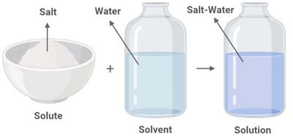
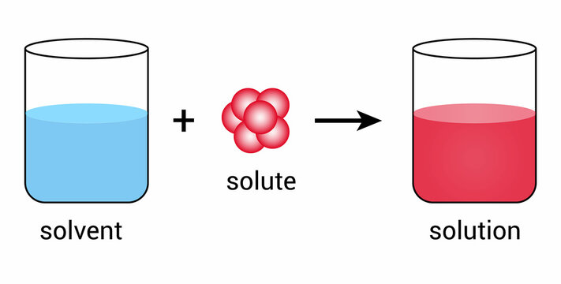
SOLUTION
Contains solute & solvent
Solute – the substance being dissolved, usually solid
Solvent – the substance doing the dissolving, usually liquid
Examples:
Sweet tea – sugar is solute, tea is solvent, sweet tea is solution
Kool-Aid – Kool-Aid granules are solute, water is solvent, mixed Kool-Aid is solution
Food coloring – dye is solute, water is solvent, colored water is solution

Slide 10
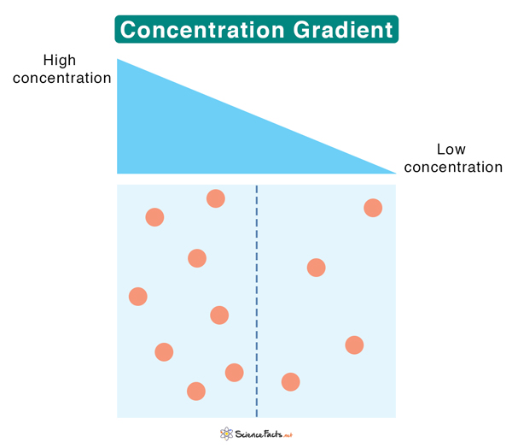
CONCENTRATION GRADIENT
Unequal distribution of particles
Occurs when concentration of particles is higher in one area than in another
To move with/down the concentration gradient – particles move from high to low, evens out areas
To move against/up the concentration gradient – particles move from low to high, makes high concentration higher and low concentration lower

Slide 11
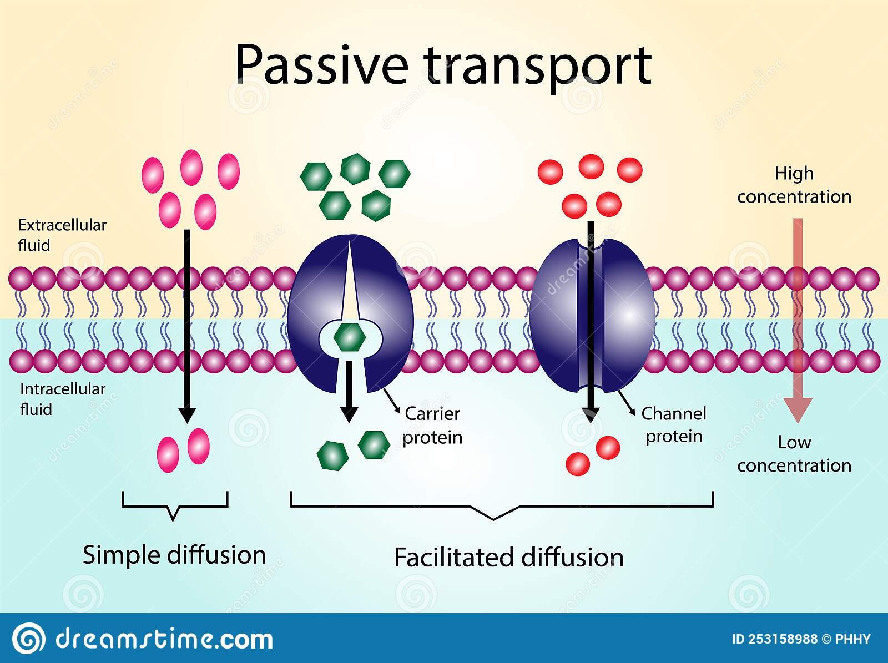
PASSIVE TRANSPORT
Movement of particles from high concentration to low concentration – with/down the concentration gradient
No energy required
Three methods:
Diffusion – movement of particles, such as gases & ions
Osmosis – movement of water
Facilitated transport – movement of larger particles, like glucose, requires carrier or channel protein

Slide 12
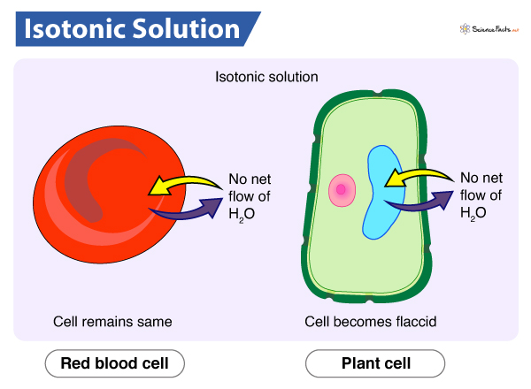
OSMOSIS
Diffusion of water from high to low concentration
Tonicity – the strength of a solution
Isotonic Solution
“Iso” means “the same”
Same concentration of solute inside and outside cell
H2O flows in & out equally

Slide 13
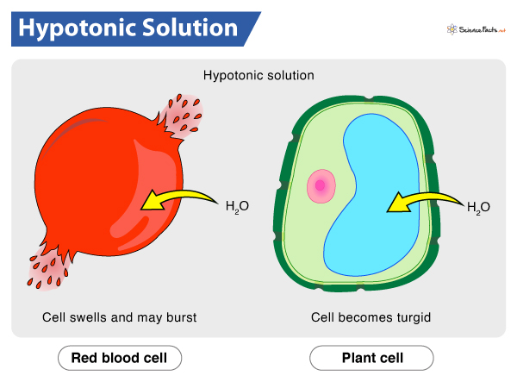
OSMOSIS
Hypotonic Solution
“Hypo” means “less than”
Solute outside cell is less than inside cell
H2O flows from outside to inside

Slide 14
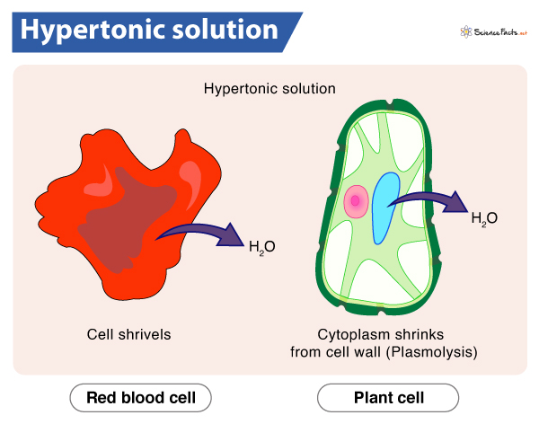
OSMOSIS
Hypertonic Solution
“Hyper” means “more than”
Solute outside cell is more than inside cell
H2O flows from inside to outside

Slide 15
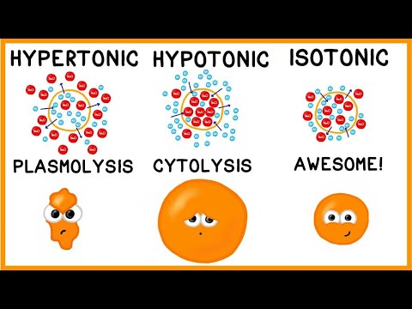
Start at 0:23
Stop at 3:52

Slide 16
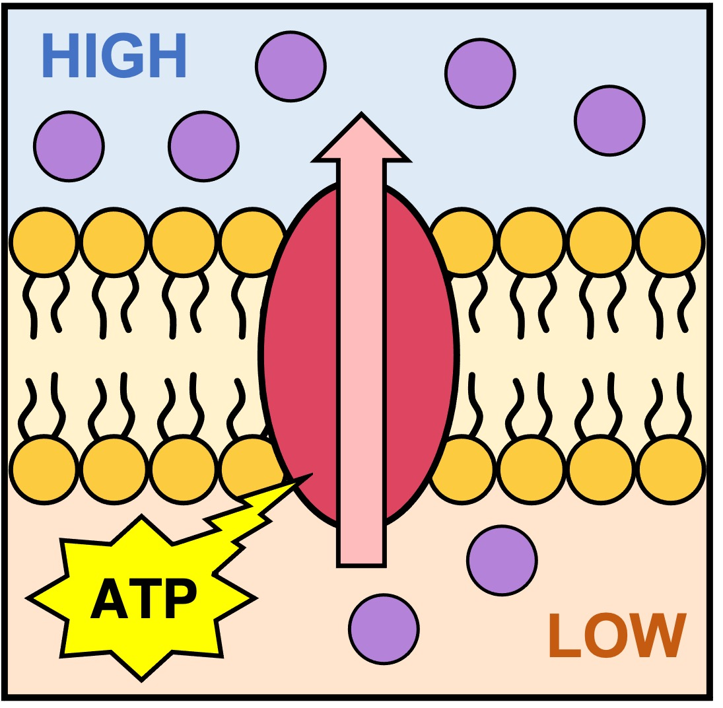
ACTIVE TRANSPORT
Movement of particles from low concentration to high concentration - against concentration gradient
Requires energy (ATP)
Three main processes:
Protein pump – carrier proteins transport molecules against gradient
Exocytosis – transport of materials out of cell
Endocytosis – transport of materials into cell

Slide 17
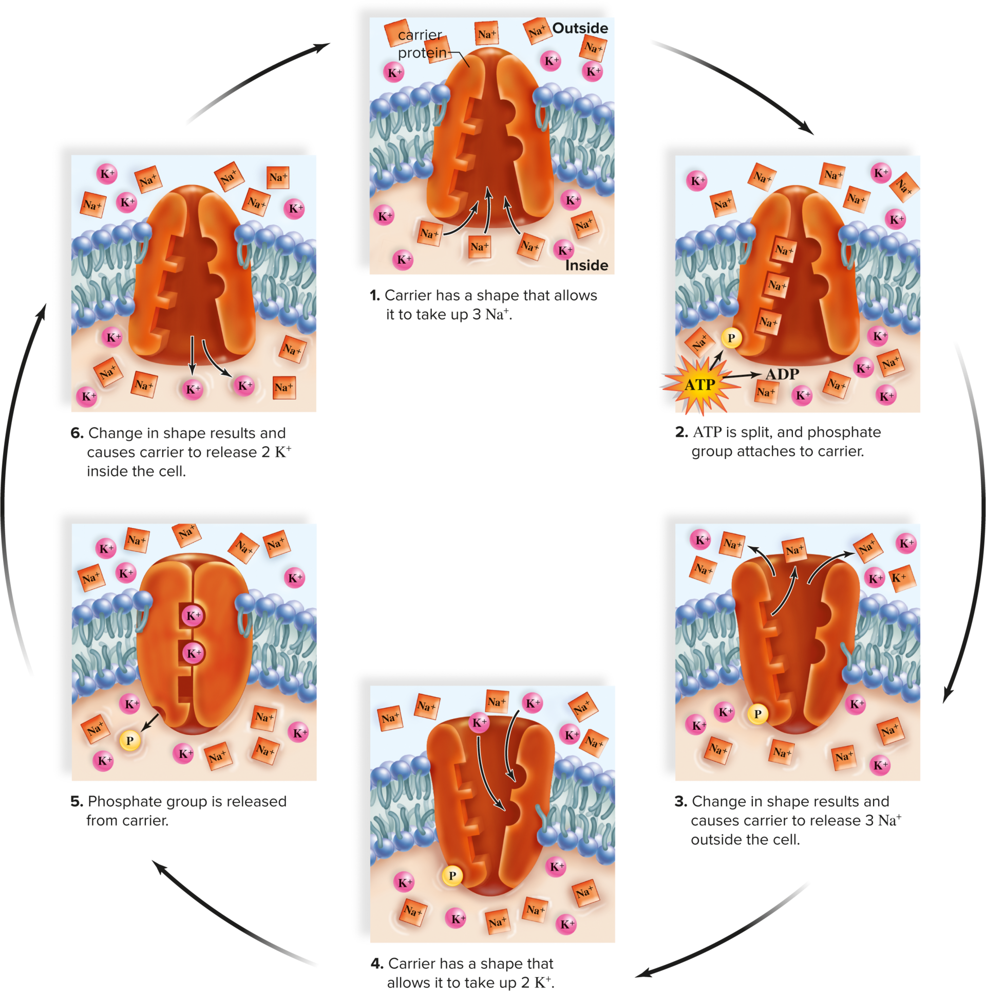
PROTEIN PUMP
Movement of particles against concentration gradient – low to high
Requires carrier proteins and ATP
Sodium-Potassium pump
Active in all animal cells
Most associated with nerve & muscle cells
Moves 3 Na+ ions from inside to outside
Moves 2 K+ ions from outside to inside
Creates an electrical gradient – necessary for electrical impulses in muscles and nerves

Slide 18
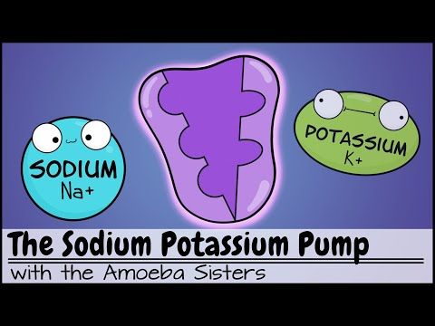
Start at 2:50
End at 4:14

Slide 19
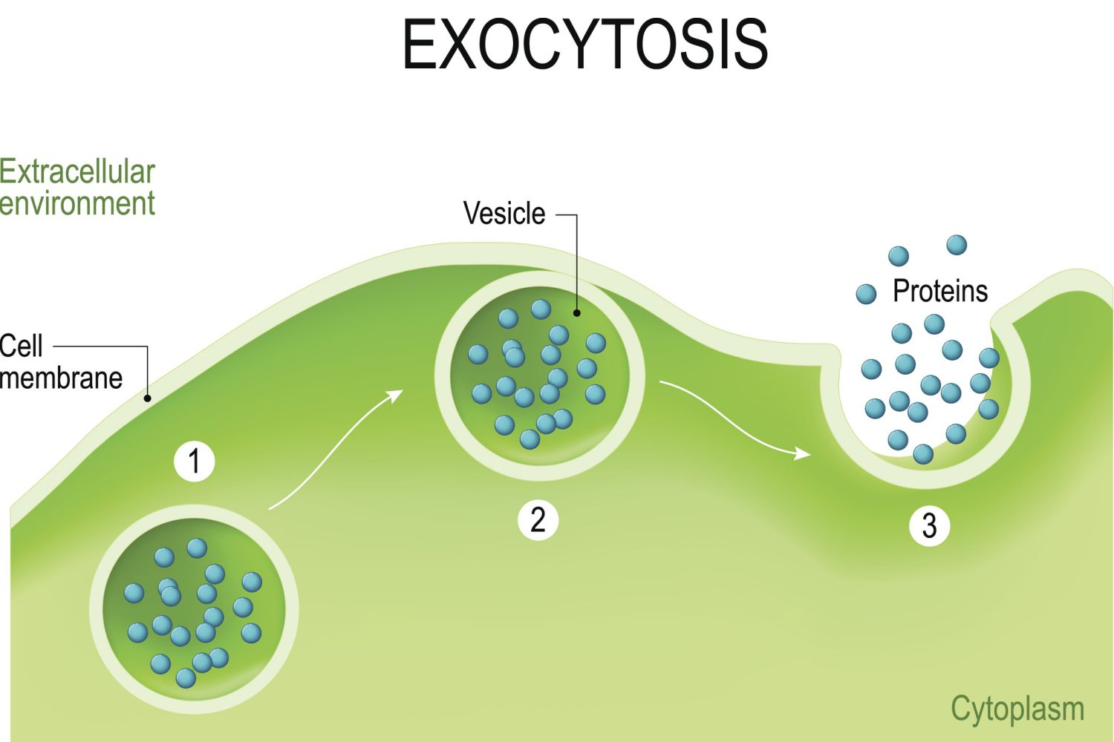
EXOCYTOSIS
Movement of molecules from inside cell to outside cell
Type of bulk transport – movement of large molecules, such as proteins, nucleic acids, & polysaccharides
1. Golgi body packages molecules into vesicle
2. Vesicle fuses with plasma membrane
3. Plasma membrane opens to expel molecules into extracellular environment

Slide 20
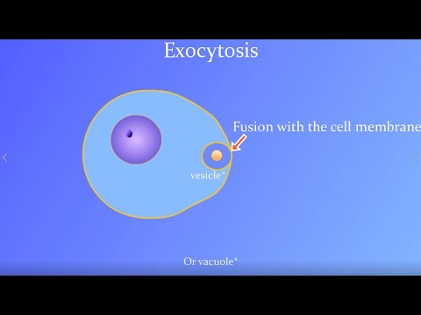

Slide 21
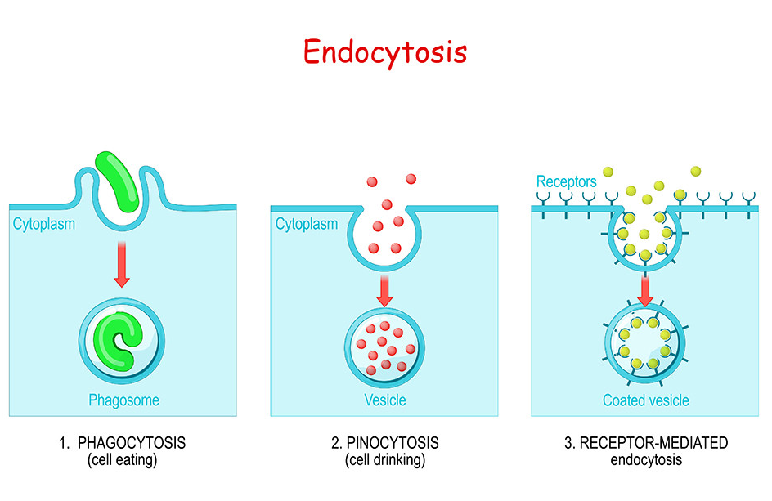
ENDOCYTOSIS
Movement of molecules from outside cell to inside cell
Type of bulk transport
Plasma membrane envelopes particle, forming vesicle
Vesicle fuses with lysosome to digest particle
Phagocytosis – “Cell eating”
Take in large molecule, such as food or other cell
Pinocytosis – “Cell drinking”
Take in liquid or small particles
Receptor-mediated endocytosis
Specialized form of pinocytosis
Requires receptor proteins to recognize & take in specific molecules

Slide 22
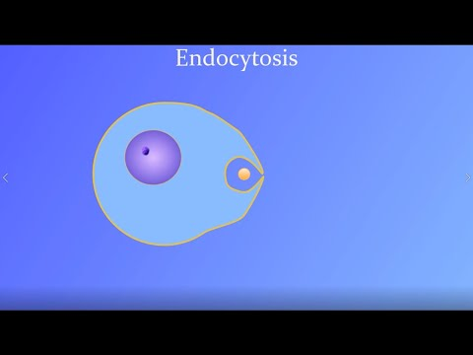

Slide 23

POSSIBLE TEAS QUESTION
Which of the following statements about diffusion is true? Select all that apply.
Diffusion is the net movement of molecules from a region of high concentration to a region of low concentration.
Diffusion is an active process.
Osmosis is an example of diffusion.
Gas exchange in tissues is an example of diffusion.
Diffusion is the net movement of molecules from a region of low concentration to a region of high concentration.
Diffusion is a passive process.

Slide 24
POSSIBLE TEAS QUESTION
Which of the following statements about diffusion is true? Select all that apply.
Diffusion is the net movement of molecules from a region of high concentration to a region of low concentration.
Diffusion is an active process.
Osmosis is an example of diffusion.
Gas exchange in tissues is an example of diffusion.
Diffusion is the net movement of molecules from a region of low concentration to a region of high concentration.
Diffusion is a passive process.

